Slide 1
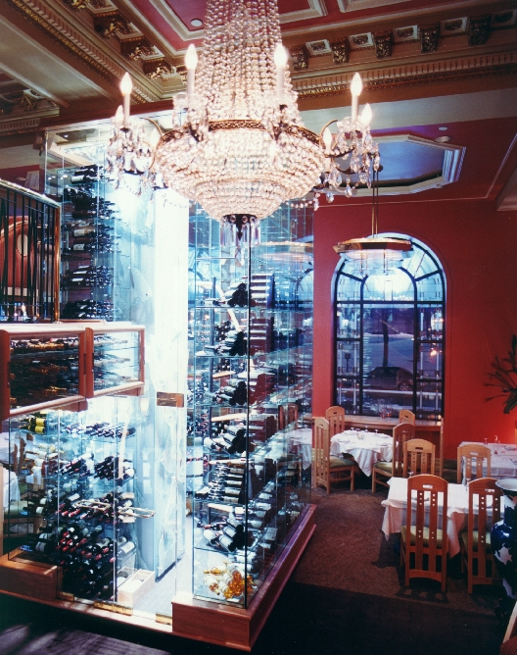
Restaurant Management System
A product from IU students
Class : Principle of Database Management System
Instructor : Mrs. Loan Nguyen
Semester II – Academic year: 2018- 2019

Slide 2

Contents
MEMBERs
INTRODUCTION
ERD
RELATIONAL DATABASE SCHEMA
DATABASE
CODING

Slide 3
MEMBERs
ĐOÀN Ý NHI
NGUYỄN THẾ ANH
HỒ ĐẶNG PHƯƠNG NGỌC

Slide 4

INTRODUCTION
Technology
COMPUTER
HUMAN

Slide 7
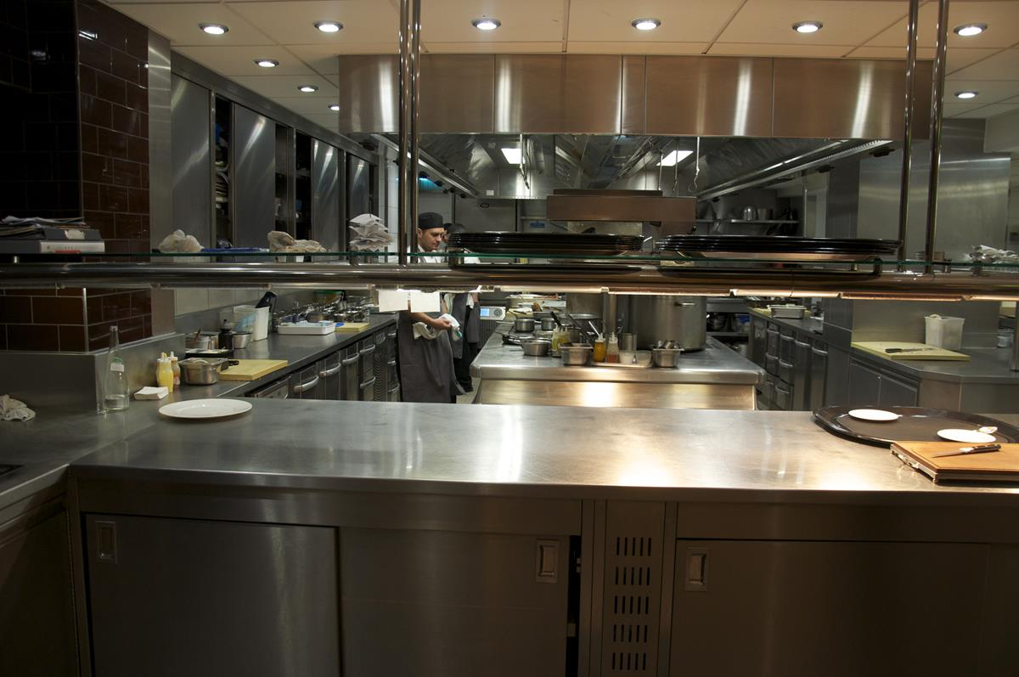

HOW IT WORKS ?

Slide 8
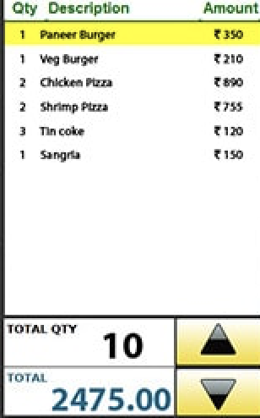
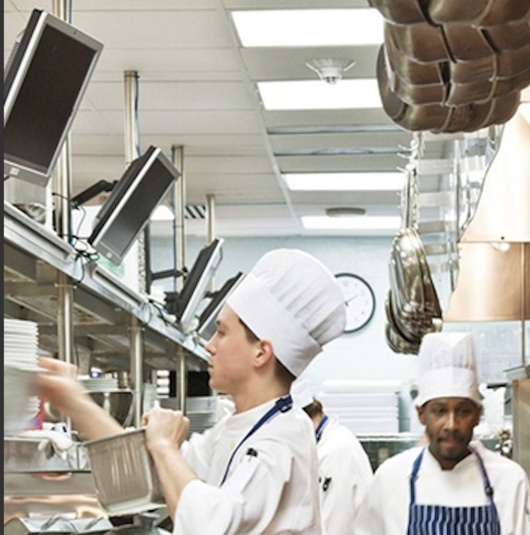

Slide 9

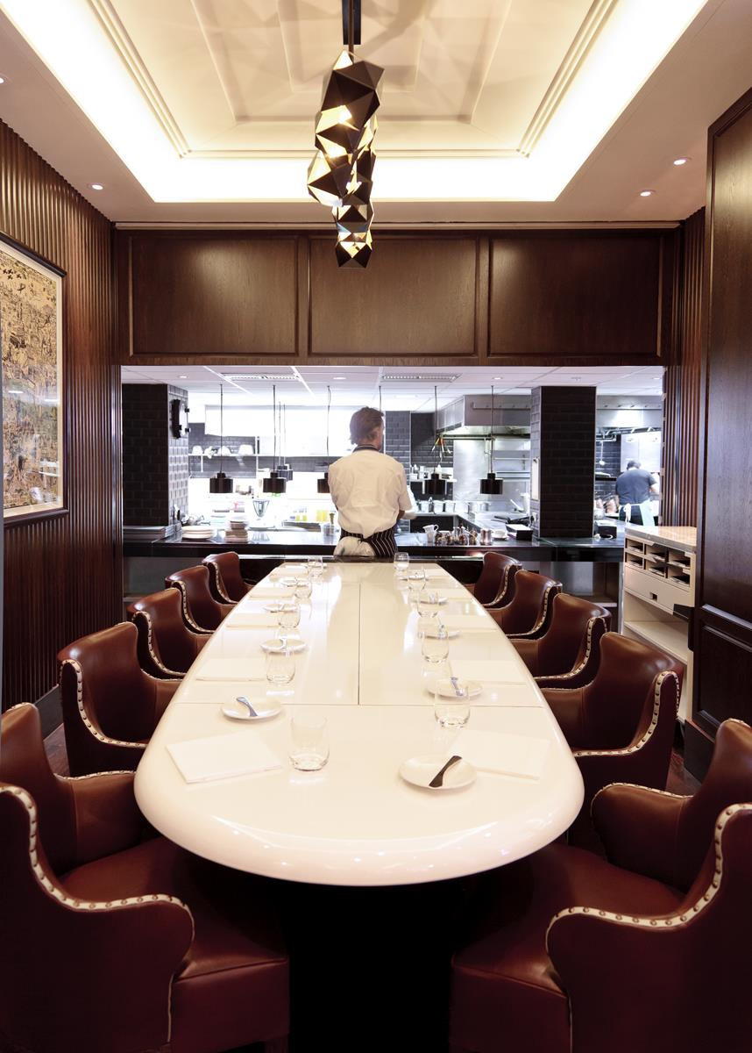
ABOUT OUR DATABASE
Notes:
Consider talking about:
Chef's table

Slide 10

ENTITY RELATIONSHIP MODEL+DIAGRAM

Slide 11
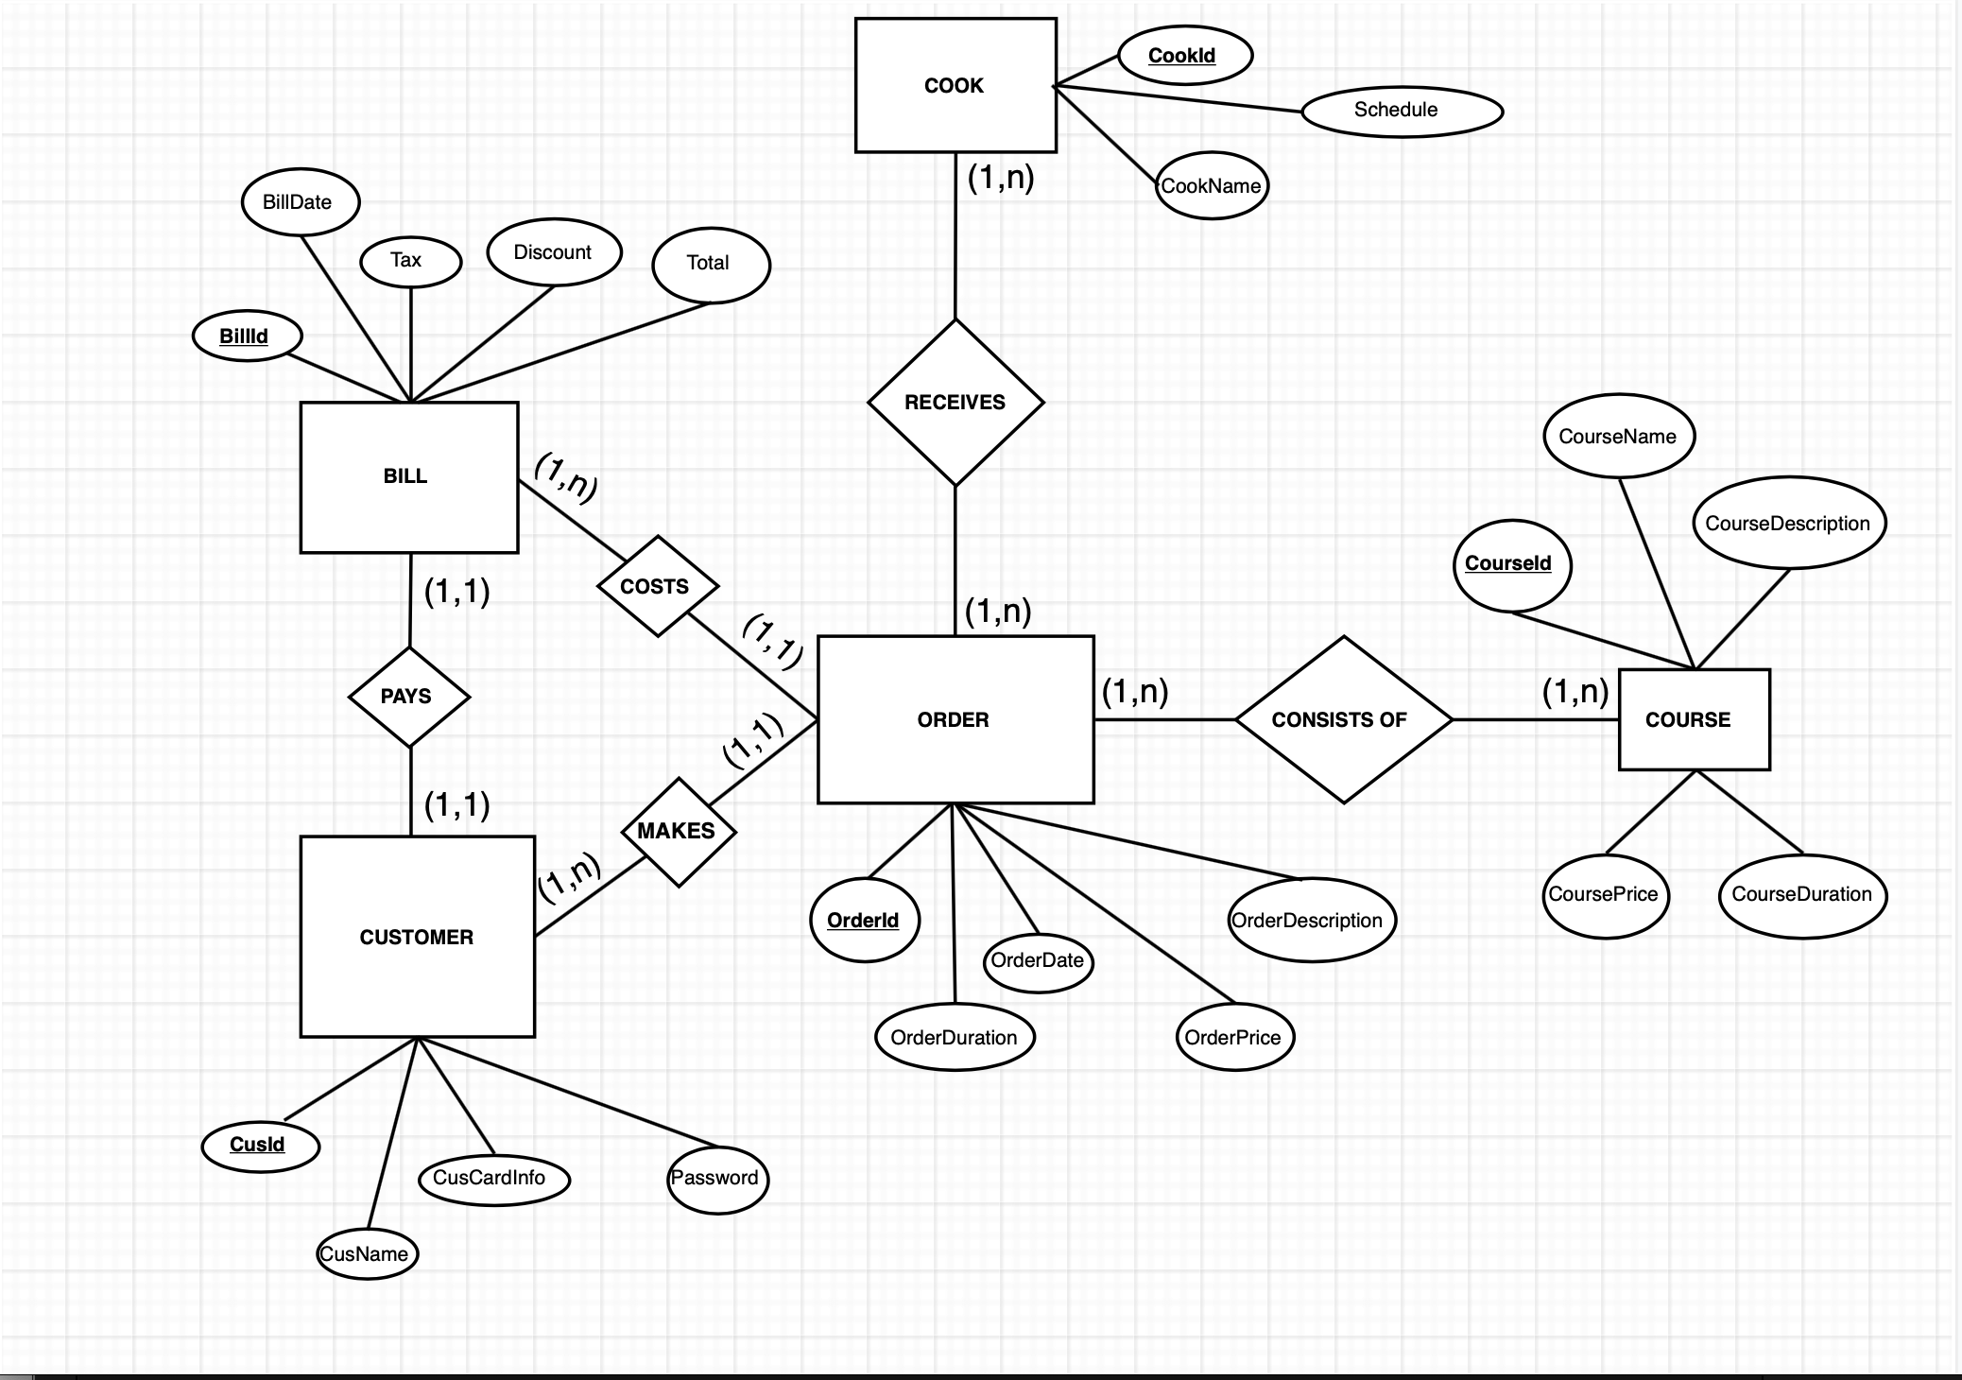

Slide 12
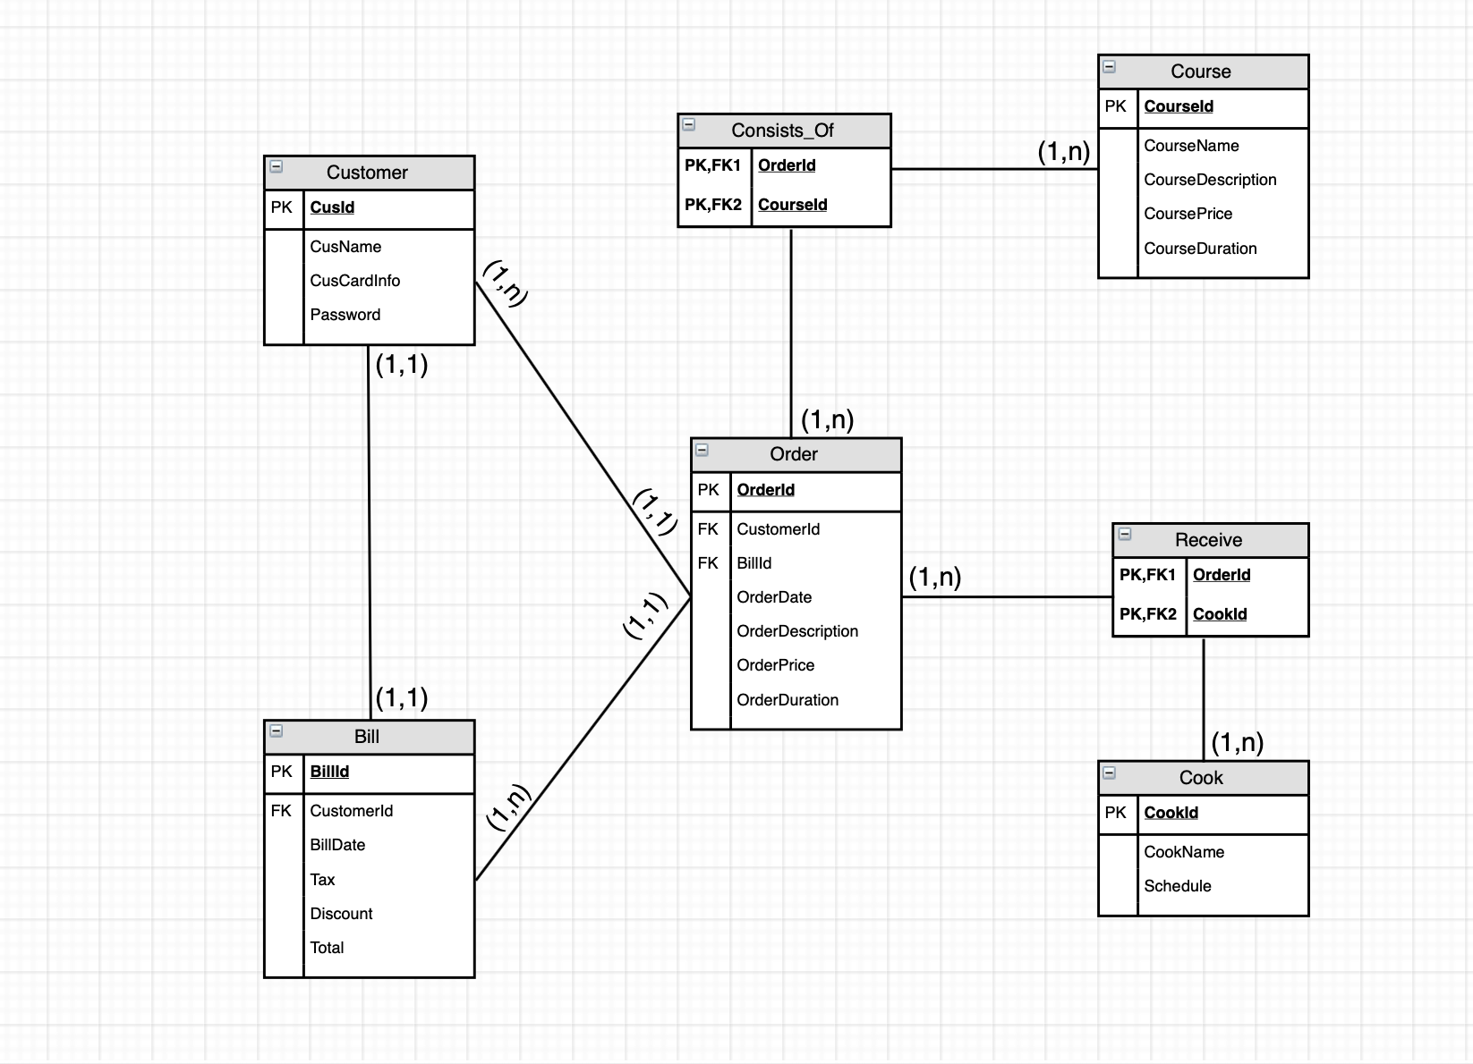

Slide 13
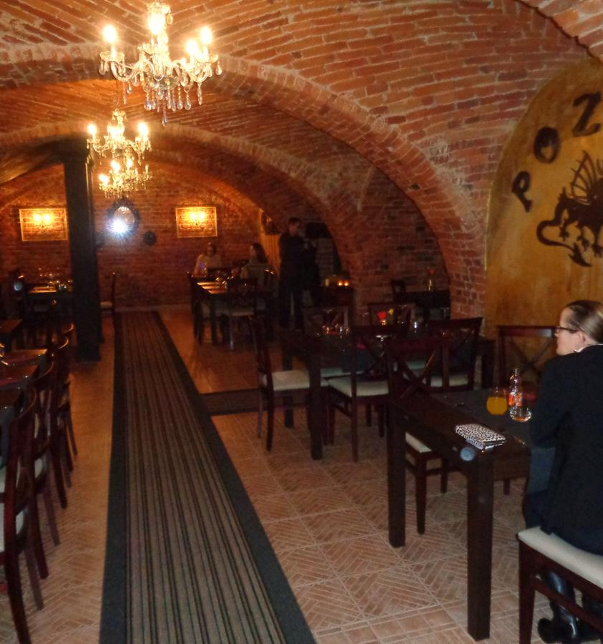

RELATIONAL DATABASE SCHEMA
Notes:
Consider talking about:
Canada
European Union
United States

Slide 15
Customer- Schema= ( CusId, CusName, CusCardInfo , Password)
Cook- Schema= ( CookId, CookName, Schedule )
Course- Schema= (CourseId, CourseName, CourseDescription, CoursePrice, CourseDuration)
Bill- Schema= (BillId , CusId, BillDate, Tax, Discount, Total)
From Bill- Schema. CusId to Customer-Schema. CusId
Order- Schema= (OrderId, CusId, BillId, OrderDate, Tax, Discount, Total)
From Order- Schema. CusId to Customer- Schema. CusId
From Order- Schema. BillId to Bill- Schema. BillId
Consists_Of- Schema= ( OrderId, CourseId)
From Consists_Of- Schema. OrderId to Order- Schema. OrderId
From Consists_Of- Schema. CourseId to Course- Schema. CourseId
Receives- Schema= ( OrderId, CookId)
From Receives- Schema. OrderId to Order- Schema. OrderId
From Receives- Schema. CookId to Receives- Schema. CookId

Slide 16
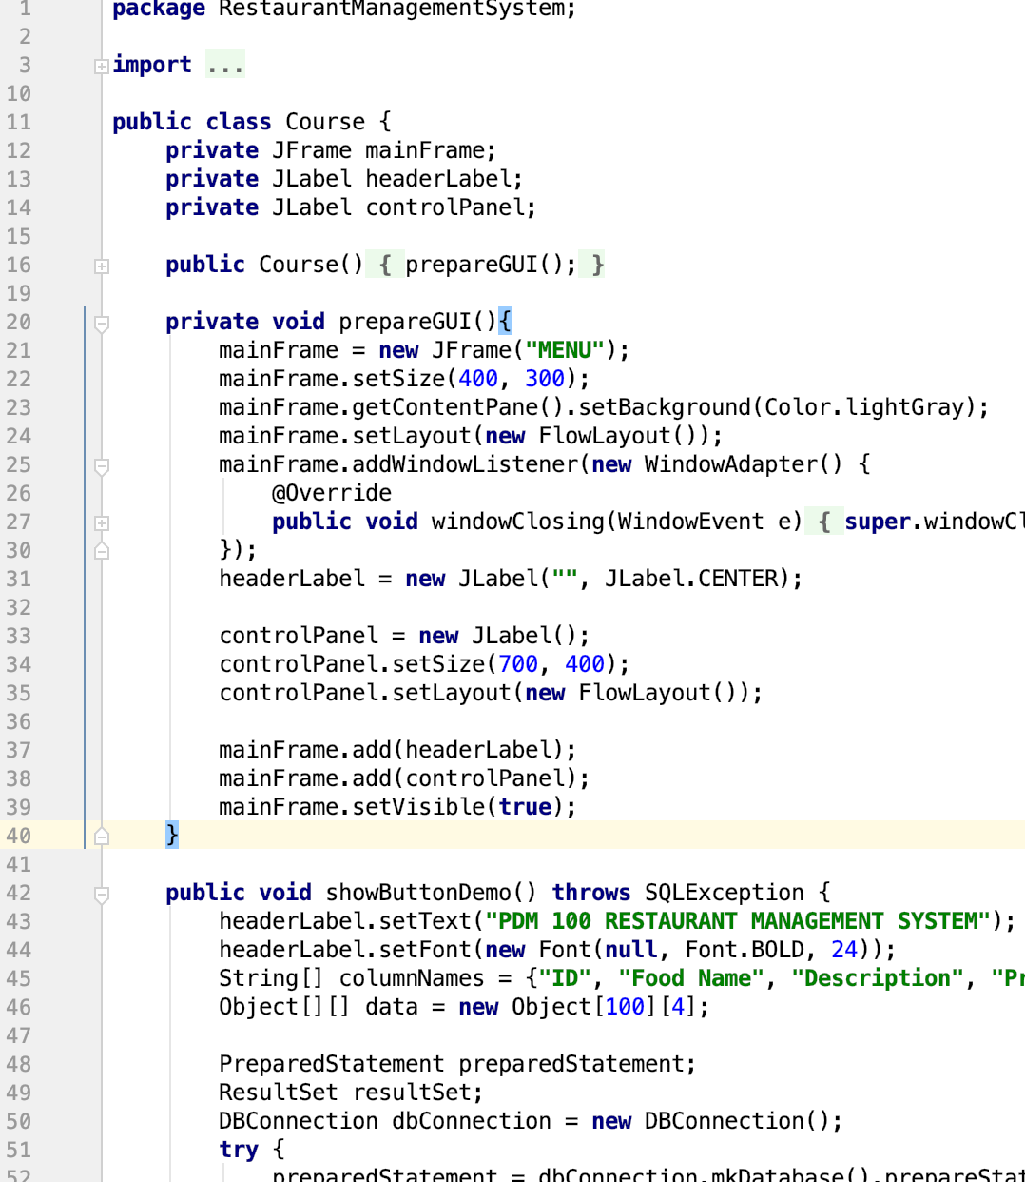
CODING and PROGRAM

Slide 17
References
STACK OVERFLOW
STACK EXCHANGE
DRAW.io
Yahoo Ask and Answer
GITHUB

